Slide 1
Excel and SPSS Tips and Tricks
Danielle K. Pearson, MSc, PhD
Suggested (APA) reference:
Pearson, D. K. (2012). Excel and SPSS tips and tricks [PowerPoint slides]. Retrieved from http://web address

Slide 2
Excel
Creating pivot tables
Transpose and Text to columns
Basic functions
Paired t-test

Slide 3
SPSS
Opening different types of files
Merging data
Selecting/Deselecting cases
Recoding variables
Identifying duplicate cases

Slide 4
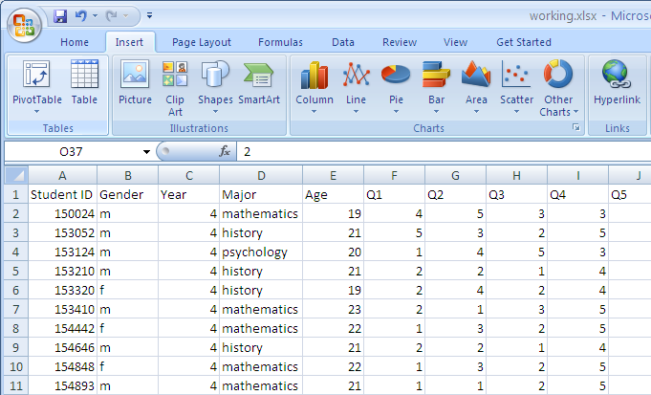
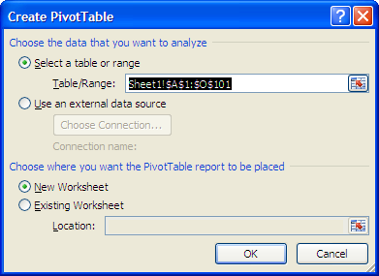
Pivot tables
Insert: Pivot table (upper left)
Brings up this menu:
Select your range of data you want included (or potentially included) in your table
Select whether you want the table in a new worksheet or an existing worksheet (if existing, select the cell in which you want the table to appear)

Slide 5
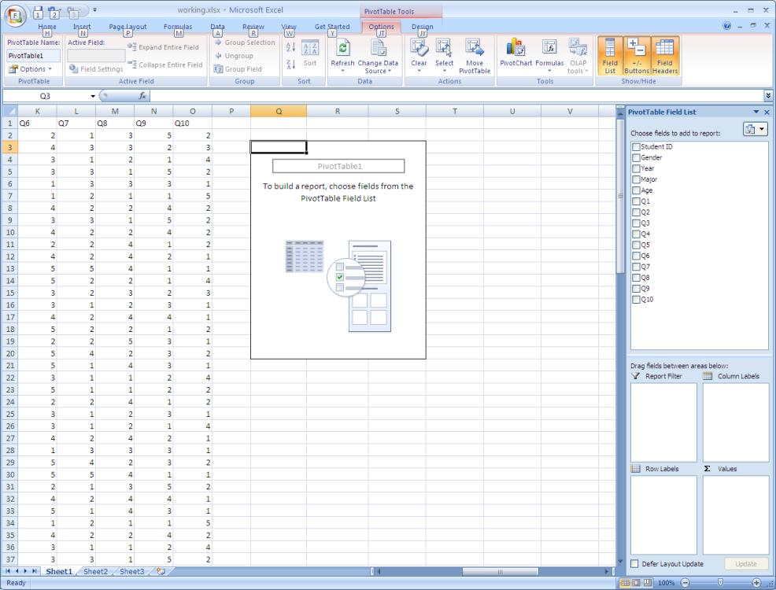
Pivot tables
Brings up pivot table tools and box at right
Select which variables you want included in the pivot table
You can check the box & it will move it automatically into box at bottom, or drag into box
The pivot table will update automatically

Slide 6
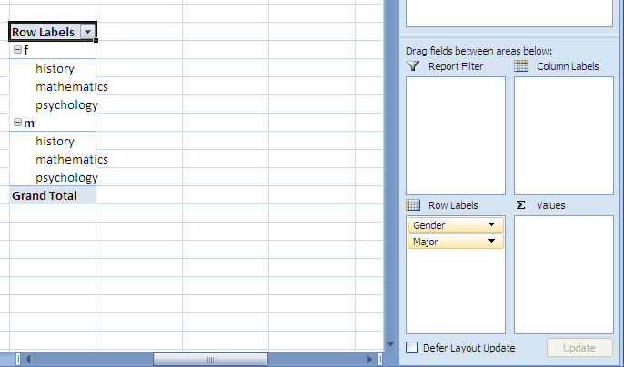
Pivot tables
Gender & Major into Row labels

Slide 7
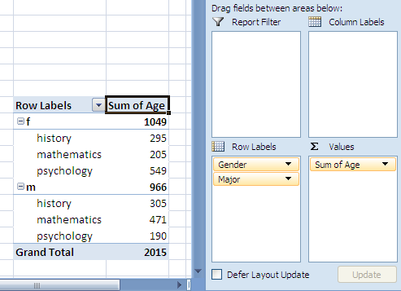
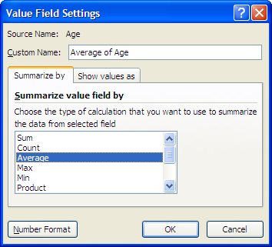
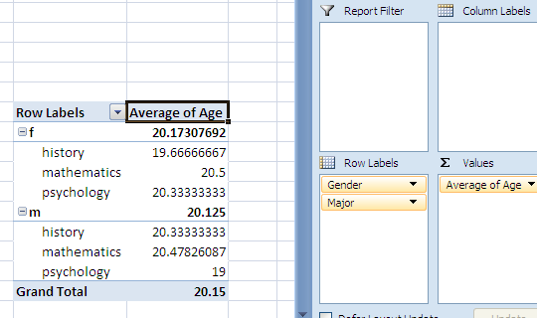
Pivot tables
Gender & Major into Row labels
Age into Values...
Summing age doesn’t make sense
Click on drop-down arrow next to Sum of Age > Value Field Settings > Average (or whatever you want for that variable)
OR right click Sum of Age in table > Summarize Data By > Average
*Change decimal places as normal: Format cells or in toolbar

Slide 8
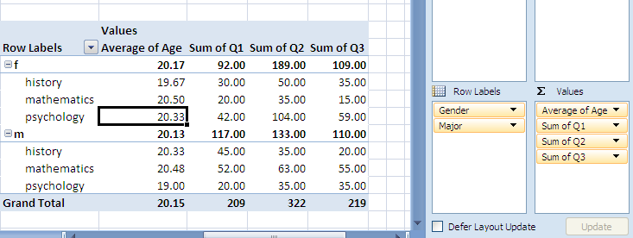
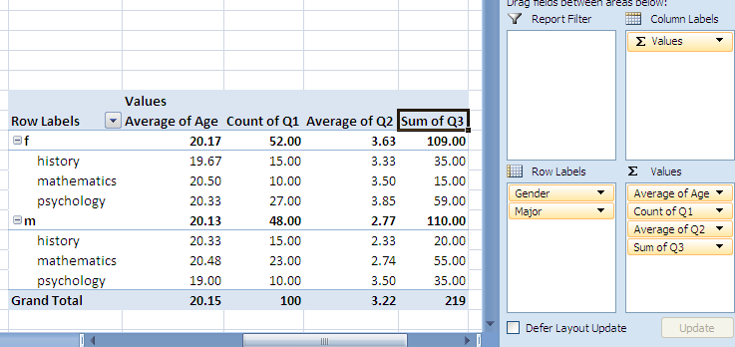
Pivot tables
Same for other variables
Interested in counts/averages/sums, etc for variables
Change in same manner as on previous slide

Slide 9
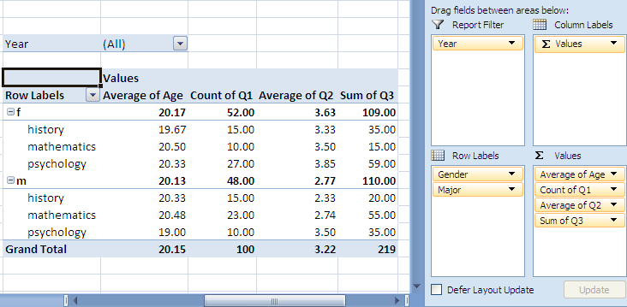
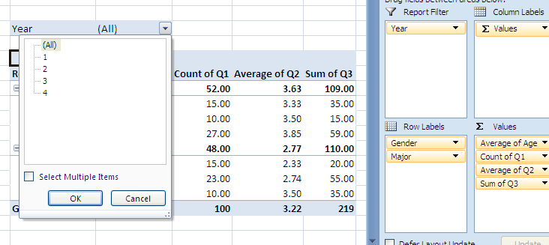
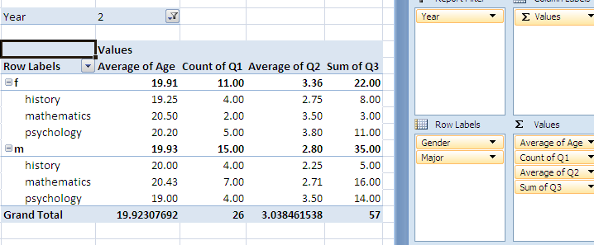
Pivot tables
Filter by variable (ex: year)
Select value(s) (year(s)) to show in table

Slide 10
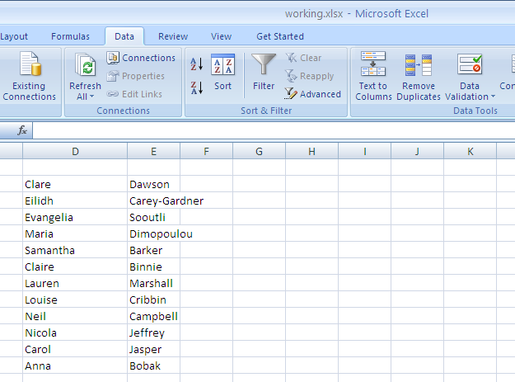
Transpose & Text to Columns
How to get from a list like this:
To a list like this:

Slide 11
Transpose & Text to Columns
Paste list into Excel
In Data tab, find Text to Columns. With cell where data is pasted selected, click Text to Columns.

Slide 12
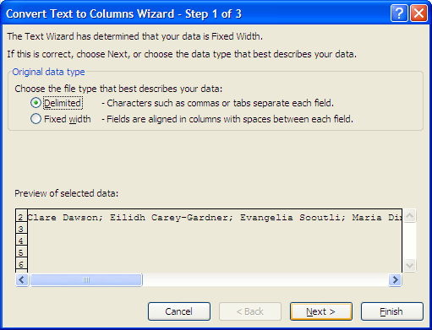
Transpose & Text to Columns
Select Delimited > Next

Slide 13
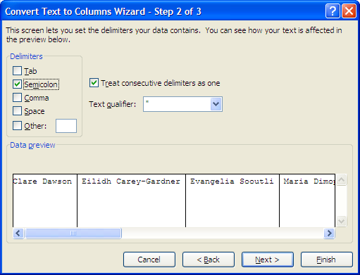
Transpose & Text to Columns
Select Delimited > Next
In this case, since names
are separated by
semicolons check
semicolon box > Next

Slide 14
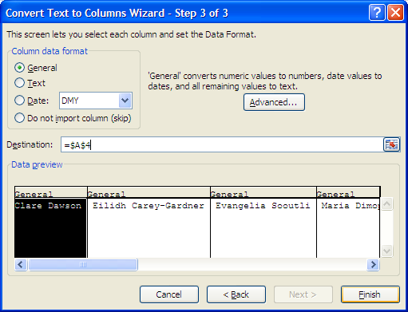
Transpose & Text to Columns
Select Delimited > Next
In this case, since names
are separated by
semicolons check
semicolon box > Next
Choose destination for columns

Slide 15
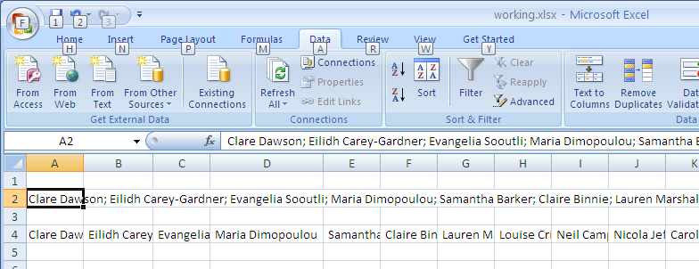
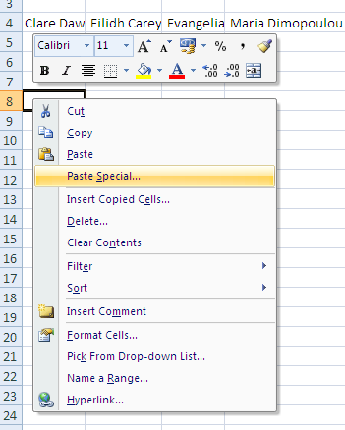
Transpose & Text to Columns
Now text will appear as one row of separate names
Highlight names, copy,
right click in a new cell
and select Paste Special.

Slide 16
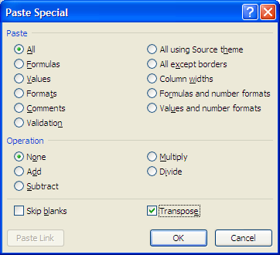
Transpose & Text to Columns
Select Transpose > OK

Slide 17
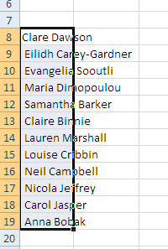
Transpose & Text to Columns
Select Transpose > OK
This will transpose the data from a row to column

Slide 18
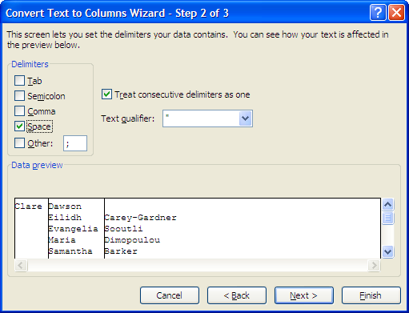
Transpose & Text to Columns
Select Text to Columns again > Delimited > Next
Select Space (since that is what separates first and last names in this case)
Preview shows that first item in list will be split differently because the other names all have a residual space in front of them. To fix this I cancelled, added a space in front of the first item, and went through Text to Columns again

Slide 19
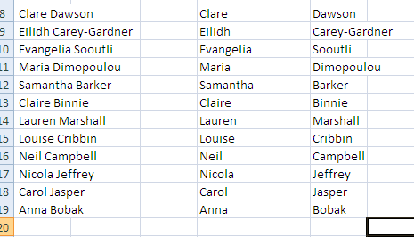
Transpose & Text to Columns
Select Text to Columns again > Delimited > Next
Select Space (since that is what separates first and last names in this case)
End result:

Slide 20
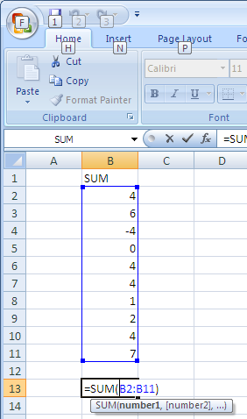
Basic Functions
Summation
Use =SUM() function

Slide 21
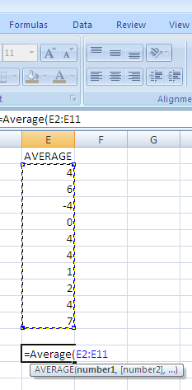
Basic Functions
Summation
Use =SUM() function
Mean
Use =Average() function

Slide 22
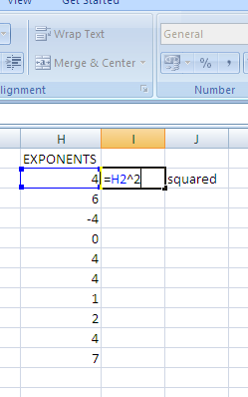
Basic Functions
Summation
Use =SUM() function
Mean
Use =Average() function
Exponents
Use =()^ function

Slide 23
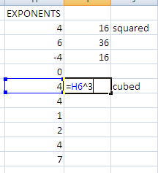
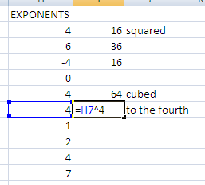
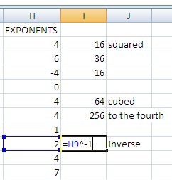
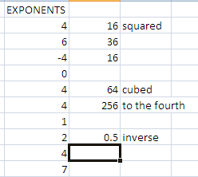
Basic Functions
Summation
Use =SUM() function
Mean
Use =Average() function
Exponents
Use =()^ function

Slide 24
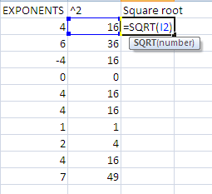
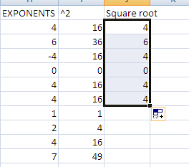
Basic Functions
Summation
Use =SUM() function
Mean
Use =Average() function
Exponents
Use =()^ function
Square root Use =sqrt() function
(All useful for finding standard deviation)

Slide 25
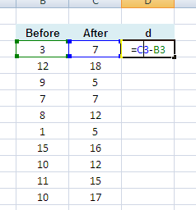
t-test
From before & after scores create column of differences

Slide 26
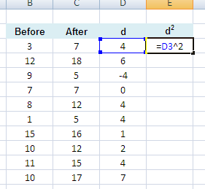
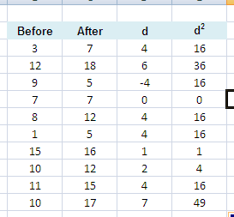
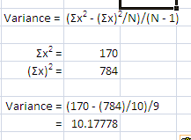
t-test
From before & after scores create column of differences
Create column of squared differences

Slide 27
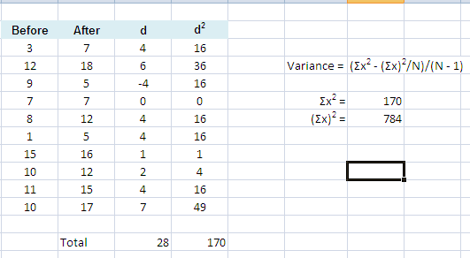
t-test
From before & after scores create column of differences
Create column of squared differences
Find variance using formula: (Σx² - (Σx)²/N)/(N - 1)
We need Σx² and (Σx)²

Slide 28
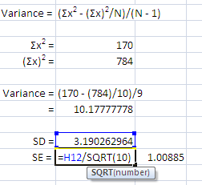
t-test
From before & after scores create column of differences
Create column of squared differences
Find variance using formula: (Σx² - (Σx)²/N)/(N - 1)
We need Σx² and (Σx)²
Standard deviation is the square root of variance
Standard error is standard deviation divided by √N

Slide 29
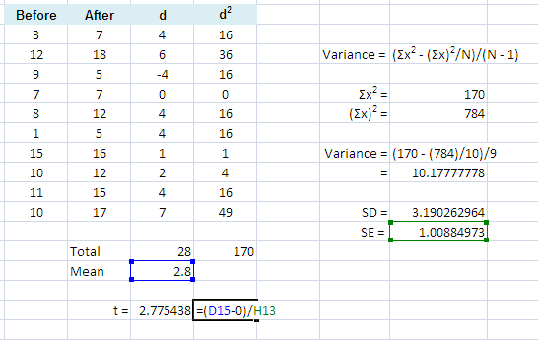
t-test
From before & after scores create column of differences
Create column of squared differences
Find variance using formula: (Σx² - (Σx)²/N)/(N - 1)
We need Σx² and (Σx)²
Standard deviation is the square root of variance
Standard error is standard deviation divided by √N
Find t using formula: t = Mean – μ
SE

Slide 30
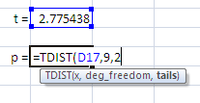
t-test
From before & after scores create column of differences
Create column of squared differences
Find variance using formula: (Σx² - (Σx)²/N)/(N - 1)
We need Σx² and (Σx)²
Standard deviation is the square root of variance
Standard error is standard deviation divided by √N
Find t using formula: t = Mean – μ
SE
Look up p value in t-table (df = 9)
OR calculate using Excel function

Slide 31
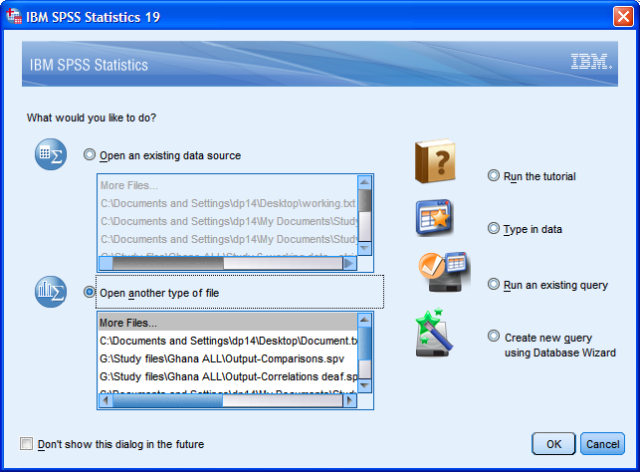
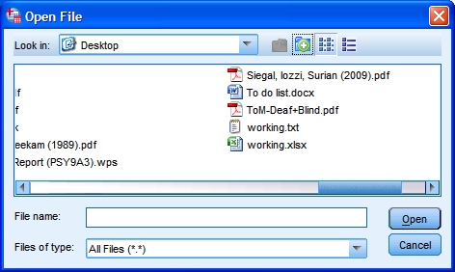
Opening data in SPSS: Text Files
When starting SPSS Select Open another type of file > OK
Locate file > OPEN
Note: If starting from a datasheet and selecting Open icon or from File menu, make sure it says All Files in ‘Files of type:’ field!

Slide 32
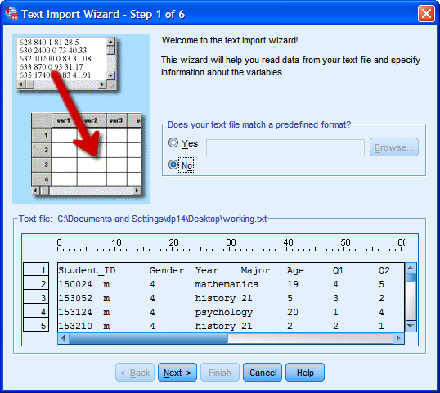
Opening data in SPSS: Text Files
This opens the text wizard:

Slide 33
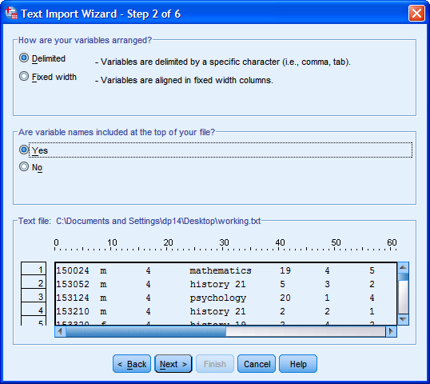
Opening data in SPSS: Text Files
This opens the text wizard:
Step 2: Selected Delimited Select Yes if your data set has variable names at the top

Slide 34
Opening data in SPSS: Text Files
This opens the text wizard:
Step 2: Selected Delimited Select Yes if your data set has variable names at the top
Step 3 & 4: Answer as applies to your data set
Step 5 allows you to set specifications for your variables, but you can always skip and do this later.
Step 6: Select Finish. (Make sure you don’t have the file open or you will get an error!)

Slide 35
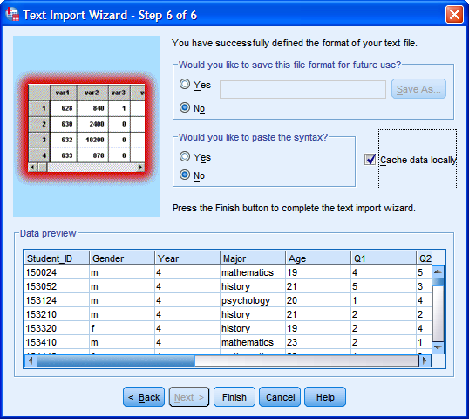
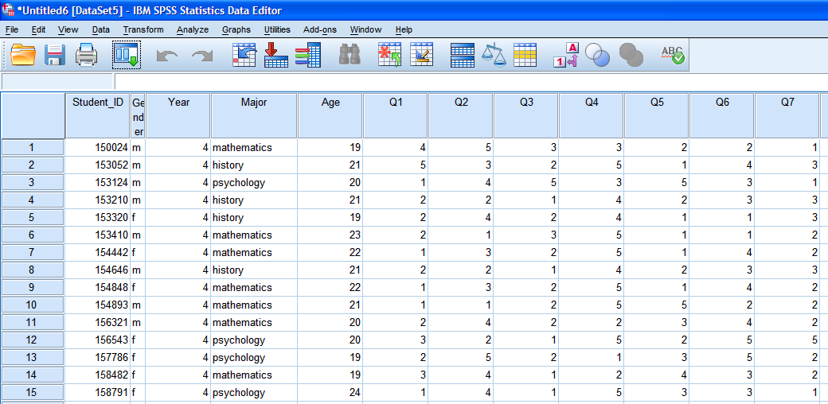
Opening data in SPSS: Text Files
Preview in Step 6
Opened data set

Slide 36
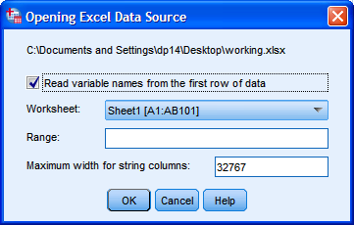
Opening data in SPSS: Excel
When opening the file, make sure Files of Type field reads either Excel or All Files.
Find and select your file.
Select the appropriate worksheet (and range, if relevant) Press OK and your dataset will open

Slide 37
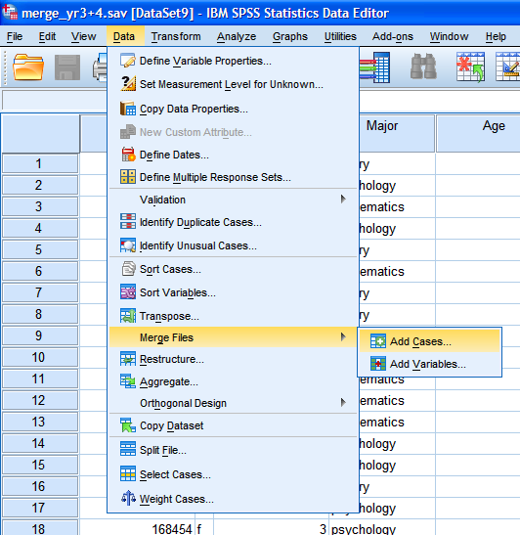
Merging data in SPSS
Adding cases
Example: You have data from 2 primary schools, and each school has its own data file. They generally have the same variables, but represent different students (cases)
Data > Merge Files > Add Cases

Slide 38
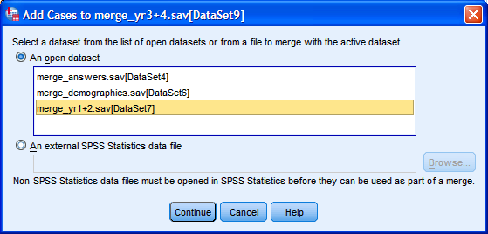
Merging data in SPSS
Adding cases
Example: You have data from 2 primary schools, and each school has its own data file. They generally have the same variables, but represent different students (cases)
Data > Merge Files > Add Cases
If your data set is already open, select it. If not, browse for it. Note: both/all files must already be SPSS files (so if they are Excel, etc, open & save in SPSS first)

Slide 39
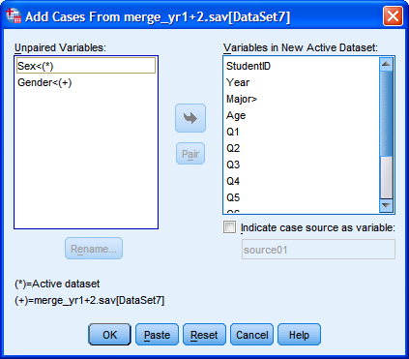
Merging data in SPSS
If any of your variables between the two files are not the same, they will appear in the left hand box as Unpaired Variables. You can add them separately to the right box if they don’t have a pair in the other set, but you want it in the final set.
If they are variables that should be the same, but were perhaps labelled differently (e.g., sex vs gender), highlight both and click Pair.

Slide 40
Merging data in SPSS
If any of your variables between the two files are not the same, they will appear in the left hand box as Unpaired Variables. You can add them separately to the right box if they don’t have a pair in the other set, but you want it in the final set.
If they are variables that should be the same, but were perhaps labelled differently (e.g., sex vs gender), highlight both and click Pair.
Select OK and all cases from both files should now be in the file you started with.

Slide 41
Merging data in SPSS
Adding variables/Match files
Example: You have data for the same participants in two different files. One file contains demographic information, the other file contains responses to a questionnaire. You want all of this information in one file.

Slide 42
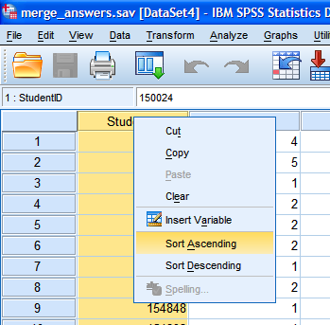
Merging data in SPSS: Match Files
VERY IMPORTANT FIRST STEP:
You need to match the cases from one file to another. To do this, you need a common indexing key. This is a unique identifier for each case in your data set (example: student ID)
This variable needs to be sorted in ascending order in BOTH files prior to merging, or you will have a problem!

Slide 43
Merging data in SPSS: Match Files
Once they are in ascending order, go to
Data > Merge Files > Add Variables
Select file to merge, similarly as in adding cases
If both keys have the same name, one will appear in Excluded Variables
(If they don’t have the same name, rename one so they are the same)

Slide 44
Merging data in SPSS: Match Files
Select the key variable on the left Select Match cases on key variable... Select Both files provide cases Click arrow to move Excluded Variable key to Key Variables

Slide 45
Merging data in SPSS: Match Files
Select OK and you will get this warning
Remember your data MUST be sorted in ascending order of your Key Variables in BOTH sets
If it is, click OK and your additional variables will be added:

Slide 46
Selecting/Deselecting cases
When your data is in SPSS, you can select only specific cases (or choose to deselect specific cases). This can be useful if you have outliers and want to run analyses on your data without them, but don’t want to delete them permanently
Example: Only want people aged 21 and under
Data > Select Cases OR Select Cases Icon

Slide 47
Selecting/Deselecting cases
Select “If condition is satisfied” to select specific cases
(And select All cases to undo this)
Click If.... And define your selection parameter Remember, this is SELECT case if...
...Click Continue
...then OK
Extra options

Slide 48
Selecting/Deselecting cases
You will be able to tell the cases that have been deselected, as they will have a line through the case number
Remember, to undo go into Select Cases and select All Cases

Slide 49
Recoding variables
Let’s say Question 10 is to be inversely scored (that is, you reverse scores so 5 = 1, 4 = 2, 3 = 3, 2 = 4, 1 = 5)
It is easy to do this in SPSS without doing it by hand
- good for large data sets & to avoid errors
Transform > Recode into Different Variables (my preference in case there’s a problem!)

Slide 50
Recoding variables
Put variable to recode in Numeric Variable ->... Box
Under Output Variable give your new variable a name (remember SPSS hates spaces in variable names!)
Label new variable accordingly Click Change
Click Old and New Values
Enter your old values and corresponding new values, and add each. Continue, OK

Slide 51
Recoding variables
Recoded variable will appear in data set

Slide 52
Identifying duplicate cases
...to make sure you aren’t analysing some cases more than once!
Data > Identify Duplicate Cases

Slide 53
Identifying duplicate cases
...to make sure you aren’t analysing some cases more than once!
Data > Identify Duplicate Cases
Define matching cases by your unique identifier
Change additional options at bottom as you wish (or leave as default)

Slide 54
Identifying duplicate cases
Output will show you how many (if any!) duplicate cases you have
Duplicate cases will be at the top of the data file so you can delete as appropriate

